Slide 1
Power BI Adoption Framework
Empower every decision maker
How to implement governance

Slide 2
Implementing Governance
Balance the needs of IT and the business
Every enterprise is unique
Determine initial principles and goals
Clarify ownerships of business information and content

Slide 3
Data Discovery
Power BI
Machine Learning
Big Data Analytics
Visualisation
Operational Reporting
Ad hoc Reporting
Centralized Control vs. Decentralized Empowerment

Slide 4
Governance Model
TIGHT CONTROLS
EDW
Permanent record
Subject to compliance
Push down content
Reporting services
BUSINESS UNIT
DASHBOARDS, KPIs & SCORECARDS
Push up content
Power BI Desktop
Excel or other reports
Knowledge management
Information sharing
DEPARTMENTAL, TEAM OR GROUP REPORTING
PROJECT REPORTING
Personal/Private views
Data science exploration
PERSONAL REPORTING
LESS CONTROLS

Slide 5









Evolution of BI
Corporate BI
Self-Service BI
Provision
Analysis
Reports
Dashboards & Scorecards
End Users
Data
Staging
ETL/Data Quality
Analysis
Cubes
Data Warehouse
Specialized Tools
?
Existing Data
Spreadsheets
LOB Applications
Data Marts
Files
IT Pro
Is it possible to balance Control with Agility?

Slide 6
A balanced approach…
Power BI
Analysis
Cubes
Data Warehouse
Existing Data
LOB Applications
Data Marts
Files
Power BI/Excel
IT Pro
End Users

Slide 7
Power BI deployment modes
Power BI delivery: three approaches

Slide 8
Power BI deployment modes
Power BI as a prototyping tool

Slide 9
Phases of delivery: Self-Service BI
Phase 2
Tactical Prototyping
& Solution Creation
Phase 1
Current State
Assessment
Repeats for each project
Phase 4
Support, Training & Expansion
Phase 3
Publishing & Monitoring
Bottom-Up

Slide 10
Phases of delivery: Corporate BI
Phase 1
Requirements Discovery
Top-Down
Phase 5
Support, Training & Expansion
Phase 2
Strategic Prototyping
Repeats for each project
Phase 4
Development
Phase 3
Blueprinting

Slide 11
Phases of Delivery: Ownership Transfer
Ownership Transfer
Phase 1 - Publishing
Business to Corporate
Phase 2 - Certification
Phase 3 – Assume Ownership

Slide 12




Data Refresh
Size Limitations
Security
Support
Benefits of ownership transfer to IT

Slide 13
Phases of Delivery: Ownership Transfer
Ownership Transfer
Phase 1 - Publishing
Corporate to Business
Phase 2 - Certification
Phase 3 – Assume Ownership

Slide 14
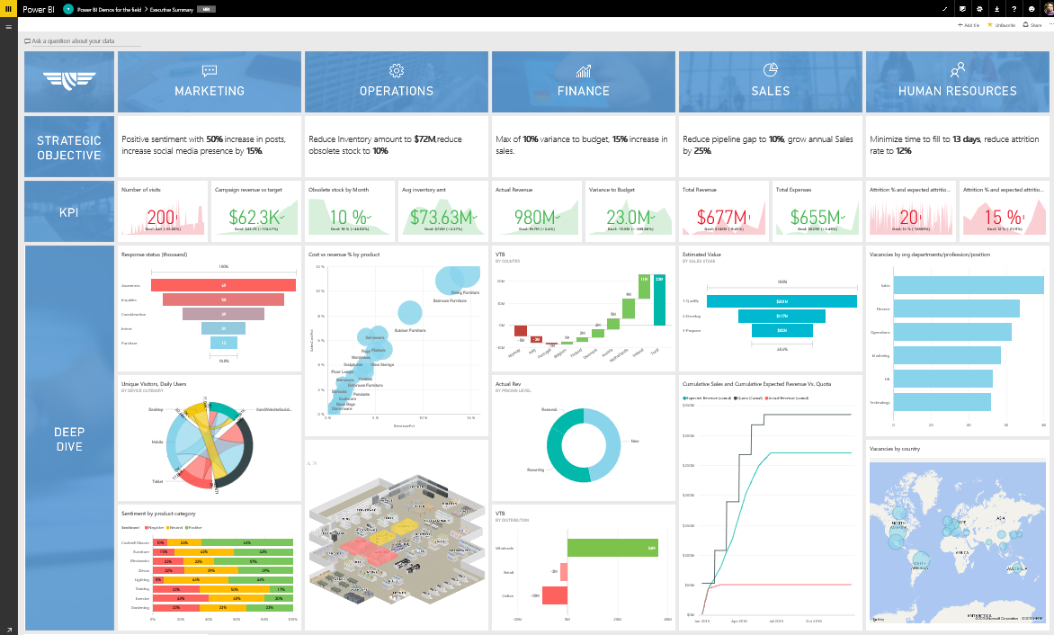
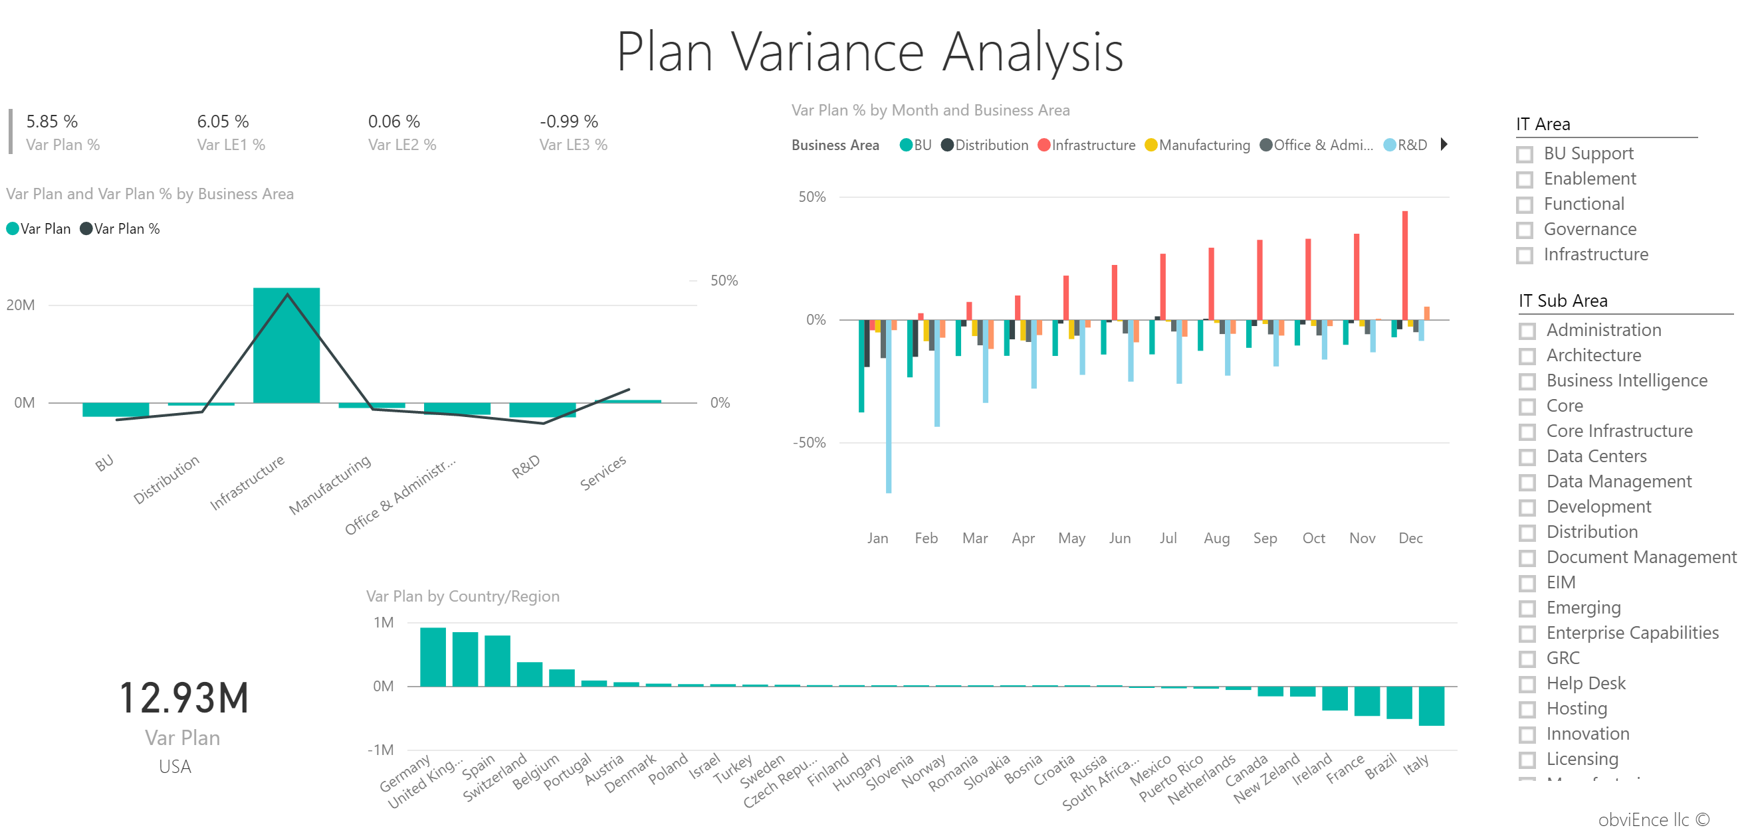
Create → Collaborate → Distribute
Development
Production
Distribute
Sharing
App Workspaces / Apps
Mobile apps
Embedding in apps
Static: PPT, Email
Other: Cortana, Publish to web, Static (Alerts, Print)
App Workspaces
App Workspaces
Co-owned Dashboards
Co-owned Dashboards
Co-owned Reports
Co-owned Reports
Co-owned Datasets
Co-owned Datasets
Co-owned Content packs
Co-owned Content packs

Slide 15





Common criteria to gauge success:
User adoption
Corporate sponsorship
Power BI champions
Approach to governed and ungoverned data sources
Developing a culture of analytics

Slide 16
System usage
Security
Report performance
Data source usage
Governance Monitoring

Slide 17
Governance Considerations
Does BI start top down or bottom up?
Where does change start? Technology or people?
Who should be allowed to see and use business intelligence data?
Fail quickly? What do you mean by that and how does it apply to business intelligence?

Slide 18
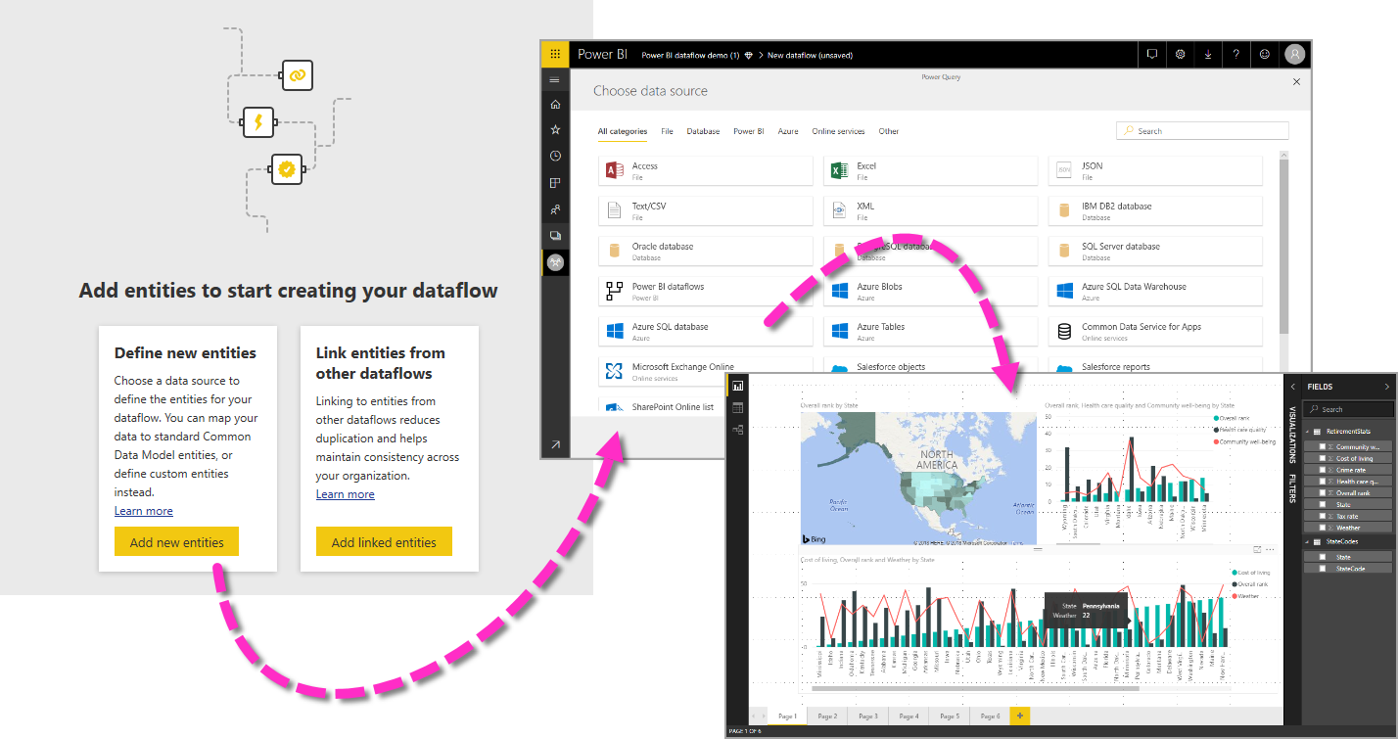
IT prepared and cleansed enterprise-wide master data
Master Data Management

Slide 19
Do you currently have a Master Data Management Process?
Actions
Document current process

Slide 20
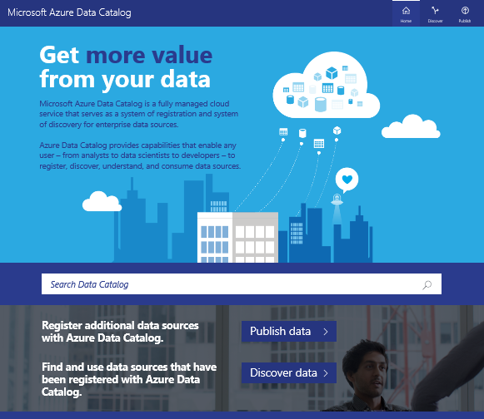
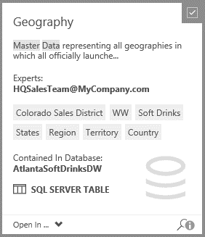
One stop reference directory for all Enterprise Data Assets
Enterprise Data Catalog

Slide 21
Do you currently have an Enterprise Data Catalog?
Actions
Document current implementation

Slide 22
Field Name | Source | Calculation | Description
Gross Profit | dbname.servername | …….. | ……..
Enterprise Data Dictionary

Slide 23
Do you currently have an Enterprise Data Dictionary?
Actions
Document current implementation

Slide 24
Marketplace Offerings
Notes:
https://appsource.microsoft.com/en-gb/marketplace/consulting-services?product=power-bi

Slide 25
Thank you

